Slide 1
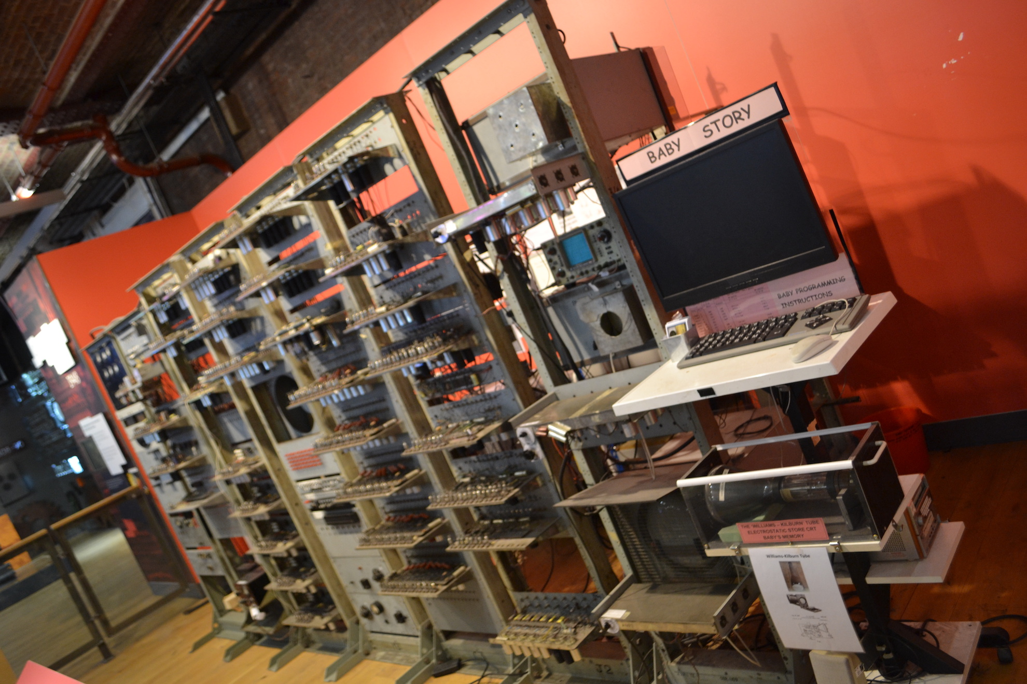

Open Elections Data Platform (OEDP)
LAM-TECH Consulting Enterprises
The Case for Sierra Leone
LAMTECH.SL
Notes:
An Open Source elections database platform following the nine open elections data principles developed by the Open Elections Data Initiative (OEDI)

Slide 2
Background
Free and fair elections are essential to the credibility of an incoming government and Promote the democratic process
The first Presidential and Parliamentary elections in Sierra Leone were held in 1924, and 1985, respectively.
we have Presidential, Parliamentary, Council and Mayoral elections in Sierra Leone. All were held on the same day in 2012, and all will be held on the same day, on March 7, 2018.
There is a need for a technology tool that will enable the national election bodies, election observers, journalists, researchers and the general public to effectively and efficiently collect aggregate, visualize and share election data
Leadership attained via controversial or contested election results leads to citizens’ lack of confidence in a new government
LAMTECH.SL
Notes:
Public confidence in each step of an election process is critical to the integrity of the election.
Citizens not only have a right to participate in elections, they have a right to know for themselves whether the electoral process is valid.
Access to information about each phase of the election process is fundamental to creating and reinforcing public confidence in elections
In order for citizens to participate in, understand, evaluate and, ultimately, accept an election process and its outcome as representing their will, election data must be open to citizens
When these conditions are met, citizens can, among other things, use election data to participate more fully as voters or contestants, make informed choices about whom to elect, understand and accept how winners are determined, recommend reforms to improve the next election and hold electoral stakeholders accountable
Open election data enhances the inclusiveness, transparency, accountability and competitiveness of elections.
Election data is open when it is released in a manner that is timely, granular, available for free on the internet, complete and in bulk, analyzable, non-proprietary, non-discriminatory and available to anyone, license-free and permanent

Slide 3
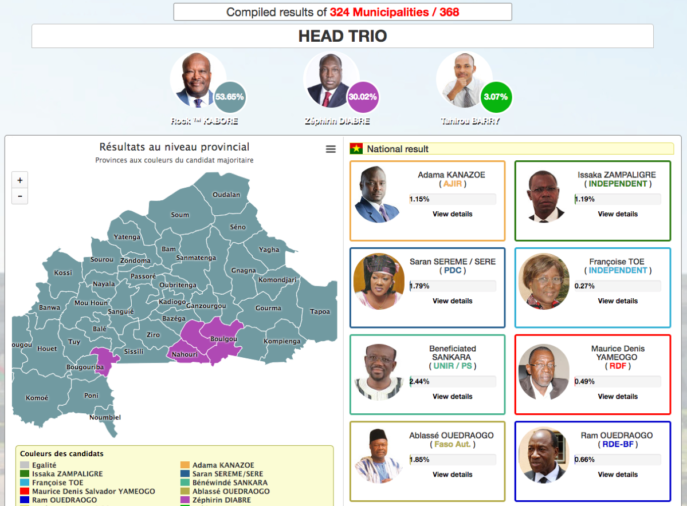

Case Study: Burkina Faso
“They used open data technology, tools and skills to ensure that official election results were securely shared with as wide a group as possible as quickly as possible”
LAMTECH.SL
Notes:
Burkina Faso’s election commission worked with the country’s open data team to publish real-time, verified election results the day after the presidential elections of November 2015.
The election commission saw speedy results publication as a way to minimise the high-risk, rumour-prone election count period that can last for several days in African countries
Burkina Faso’s 2015 presidential elections took place without incident, and were regarded as a success by observers, with the other candidates conceding defeat before the result was announced at the end of that day immediately following the vote
The project succeeded in its immediate aim: to use open data technology, tools and skills to ensure that official election results were securely shared with as wide a group as possible as quickly as possible.

Slide 4
What is Open Election Data Platform (OEDP)?
OEDP is an open source open election data platform to facilitate free, fair, safe, secured and transparent elections.
The platform enables data collection, data aggregation, data visualization, and data sharing of election results, candidate profiles, boundary delimitations, polling stations, voter registration centers, political party information, electoral news articles, electoral education materials and political violence incident reports in accordance with global open election data principles
The platform’s sub-system Electoral Violence Education and Reporting (EVER) database system is a crowd sourcing application that enables thousands of users across the country to send location based political violence incident reports via SMS, Twitter, Facebook, email, mobile app and web application.
LAMTECH.SL
Notes:
OEDP gives researchers, students, journalists, data gurus, civil society and the public access to historical election data in human and machine-readable formats for presidential, parliamentary, mayoral, district chairperson, local council, and village headman elections in Sierra Leone.

Slide 5
What is Open Election Data Platform (OEDP)?
The platform gives researchers, journalists, data gurus, civil society, political campaigns and the general public access to historical election data in human and machine-readable formats for presidential, parliamentary, mayoral, district chairperson, local council, and village headman elections in Sierra Leone.
Election bodies like NEC and NEW, Ministries, Departments and Agencies (MDA) like The Ministry of Internal Affairs, the Office of National Security (ONS), The Sierra Leone Police Force (SLPF), The Ministry of Information and Communications, the Right to Access Information, the Open Government Initiative (OGI), and many more will benefit from this tool.
The Data collected, aggregated and shared by this tool can be used to enhance the work of the above MDAs, researchers, Civil Society Groups and NGOs.
The main platform is currently available at https://electiondata.io with demo data from Sierra Leone
The Sierra Leone instance of the platform is available at https://elections.sl with historical data covering 1996, 2002, 2007 and 2012 elections.
LAMTECH.SL
Notes:
OEDP gives researchers, students, journalists, data gurus, civil society and the public access to historical election data in human and machine-readable formats for presidential, parliamentary, mayoral, district chairperson, local council, and village headman elections in Sierra Leone.

Slide 6









Main Objective
Provide an open source and open data web-based tool to collect, aggregate, visualize and share historic and current election data in a manner that is;
analyzable
Permanently-available
available-for-free on the internet
complete-and-in-bulk
granular
timely
non-proprietary
Non-discriminatory
License-free
Source: https://www.openelectiondata.net/en/guide/principles/
LAMTECH.SL

Slide 7
Why Sierra Leone OEDP?
To complement the work of current election bodies and security organizations in the country
To avoid fake news and breaking the news from official sources
The National Electoral Commission (NEC) have a website at http://necsl.org/ where it already publishes election data
This is great and we applaud NEC for doing so.
However, we noticed that the current data is not published following the nine principles of open election data.
We also know that it is very expensive to procure the tools to enable publishing election data based on the principles of open election data
The National Elections Watch (NEW) published http://salonevote.com in 2012, where data about poll opening, closing and counting, polling station set-up, polling station location, general voting procedures, voter demographics, provisional results were published
This is another excellent tool that is very useful on election day and right after.
However, we noticed that the current data is also not following all of the principles of open election data.
LAMTECH.SL
Notes:
There are links pointing to some election results provided in HTML tables and lists to download PDF copies of voter registration centers, official press releases, election calendar, candidates and parties and much more.
The major drawbacks to this approach are as follows;
Data published by NEW is not machine-readable and does not cover all aspects of the election process
The data made available is incomplete and their have been times when the website was not available for than 6 months in a row
Only summary election results in PDF or HTML tables are published and where granular data is available, it stops at the district level.
None of the published data is machine-readable
The data is not published in a timely manner. Takes more than 48hrs to see official press release documents on the website
During elections, results are granular results at the polling station level are not published in near real-time
There is very little information about the political parties, their members and candidates
Polling station and voter registration data lacks geographic details for mapping.

Slide 8
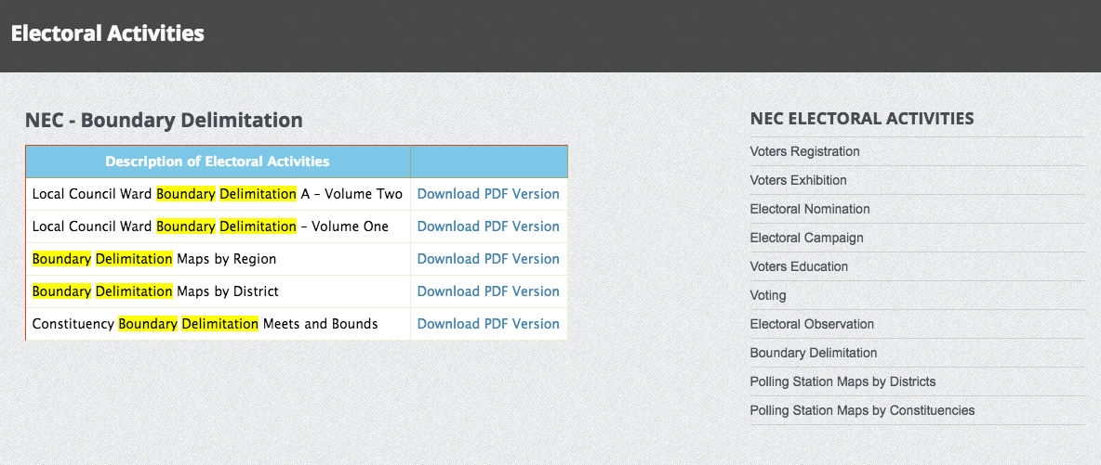
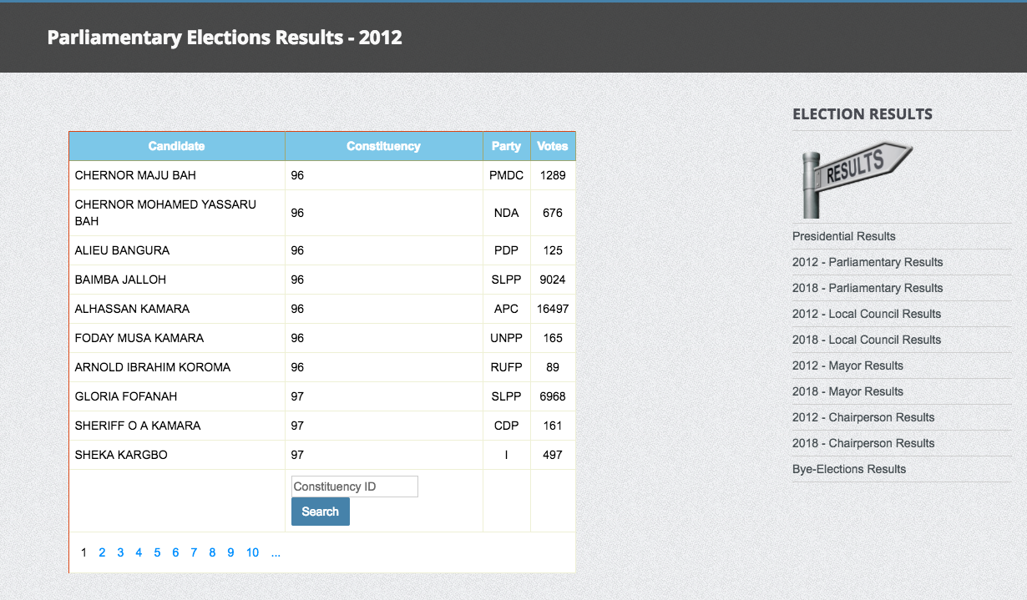
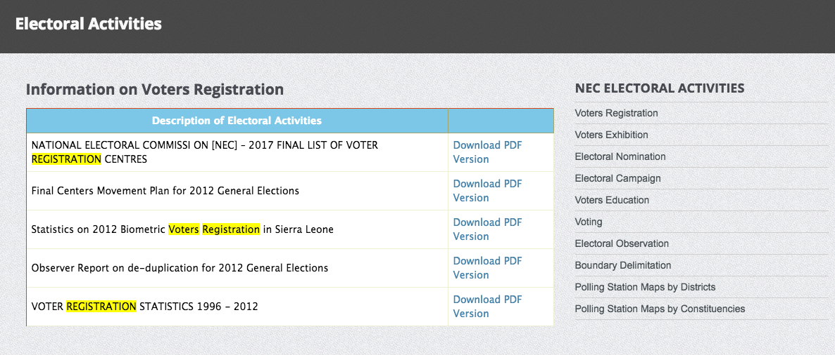
Why Sierra Leone OEDP?
PDF is not analyzable
LAMTECH.SL

Slide 9
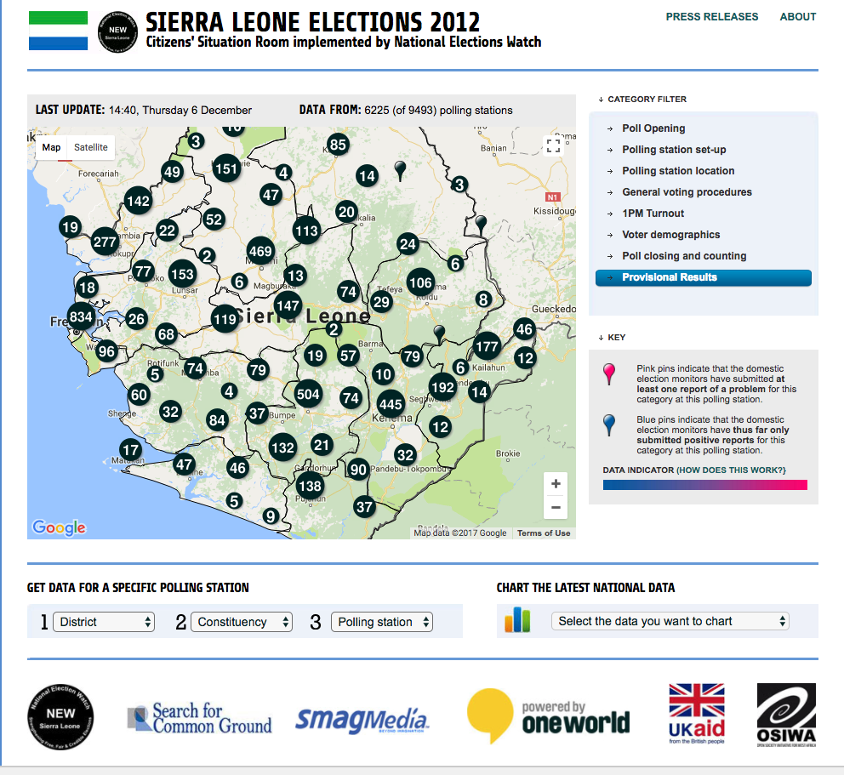
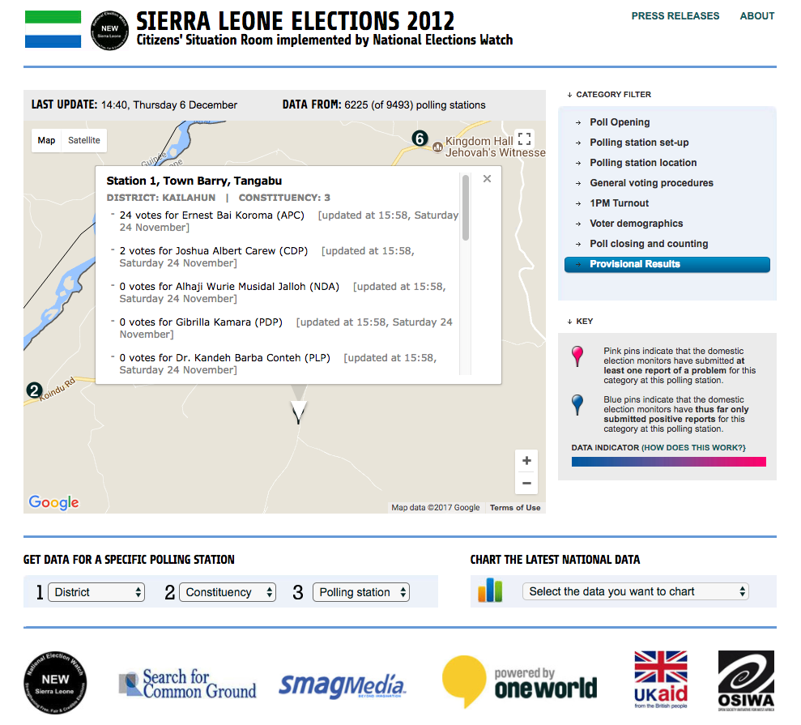
Why Sierra Leone OEDP?
There is no option to bulk download the data
LAMTECH.SL

Slide 10
Implementation Strategy
To make this a reality, LAM-TECH is donated the platform to the people of Sierra Leone
LAM-TECH will continue to manage the technology aspects and cost of the base platform at no additional cost to the country
LAM-TECH will work with major election bodies like NEC and NEW to enable their monitors and observers use the platform to publish election results in near real-time for the 2018 general elections
To effectively make use of the platform and publish election results in near real-time, LAM-TECH is recommending a total of 12,405 volunteers;
11,799 polling station data coordinators
446 ward data coordinators
132 constituency data coordinators
16 district data coordinators
5 regional data coordinators
1 national data coordinator
1 platform/product/project manager, and
5 platform technical support engineers.
LAMTECH.SL

Slide 11
Real-Time Election Results Data Flow
Manual & Automated Tallying of National Results
Create, Review and Publish moderation steps
National Data Coordinator
Manual & Automated Tallying of Regional Results
Create, Review and Publish moderation steps
East Data Coordinator
North Regional Coordinator
South Regional Coordinator
West Regional Coordinator
North-West Regional Coordinator
Manual & Automated Tallying of District Results
Create, Review and Publish moderation steps
Kailahun Data Coordinator
Kenema Data Coordinator
Kono Data Coordinator
Bombali Data Coordinator
Nth Data Coordinator
Bo Data Coordinator
Nth Data Coordinator
Western Area Urban Data Coordinator
Nth Data Coordinator
Karene Data Coordinator
Nth Data Coordinator
Manual & Automated Tallying of Constituency Results
Create, Review and Publish moderation steps
Const. 1
Const. 2
Const. Nth
Const. 78
Const. Nth
Const. 63
Const. Nth
Manual & Automated Tallying of Ward Results
Create, Review and Publish moderation steps
Ward 1
Ward 2
Ward 3
Ward 4
Ward Nth
Ward 281
Ward Nth
Ward 212
Manual Tallying of Polling Station Results
Create, Review and Publish moderation steps
Polling Station 01001
Polling Station 01002
Polling Station 01003
Polling Station Nth
Polling Station Nth
Polling Station Nth
LAMTECH.SL

Slide 12
Data Types, Input and Outputs Methods
Main Data Types
Input Methods
The Platform
Output Methods
Boundary Delimitations
Interactive HTML Maps
OpenElections
Core Platform Engine
Election Results
HTML Tables & Visual Cards
Candidate Profiles
Web form
JSON API
RSS Feed
Email
SMS
HTML Charts & Reports
Political Party Profiles
SMS & Email Alerts
Electoral News
CSV, JSON & XML Data
Political Violence Reports
Drupal 8 Web Content Management System
RSS Feeds
Election Resources
Multimedia Resources
Polling Stations/Registration Centres
LAMTECH.SL

Slide 13
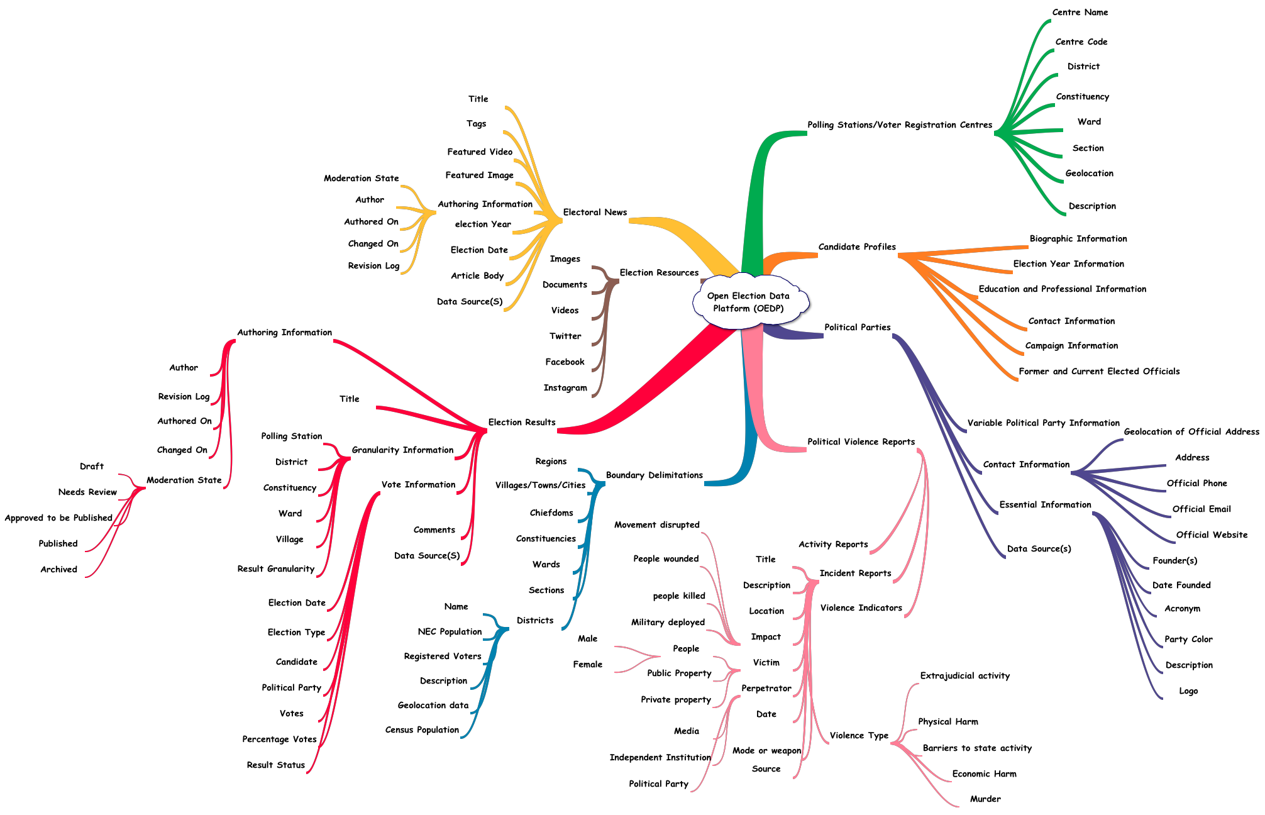
Sample Detail Data Models
LAMTECH.SL

Slide 14
Improved & Modern Data Collecting Tool
Main Data Types
Input Methods
Simple, mobile first and Responsive Form design
Data validation to avoid wrong data entry
Multiple approval levels to ensure data is verified and published by approved publishers only
Modern data structures and references
Boundary Delimitations
Election Results
Candidate Profiles
Political Party Profiles
Web form
JSON API
RSS Feed
Email
SMS
Electoral News
Political Violence Reports
Election Resources
Polling Stations/Registration Centres
LAMTECH.SL

Slide 15
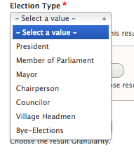
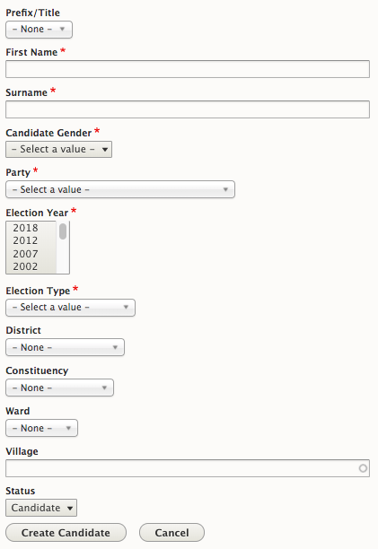
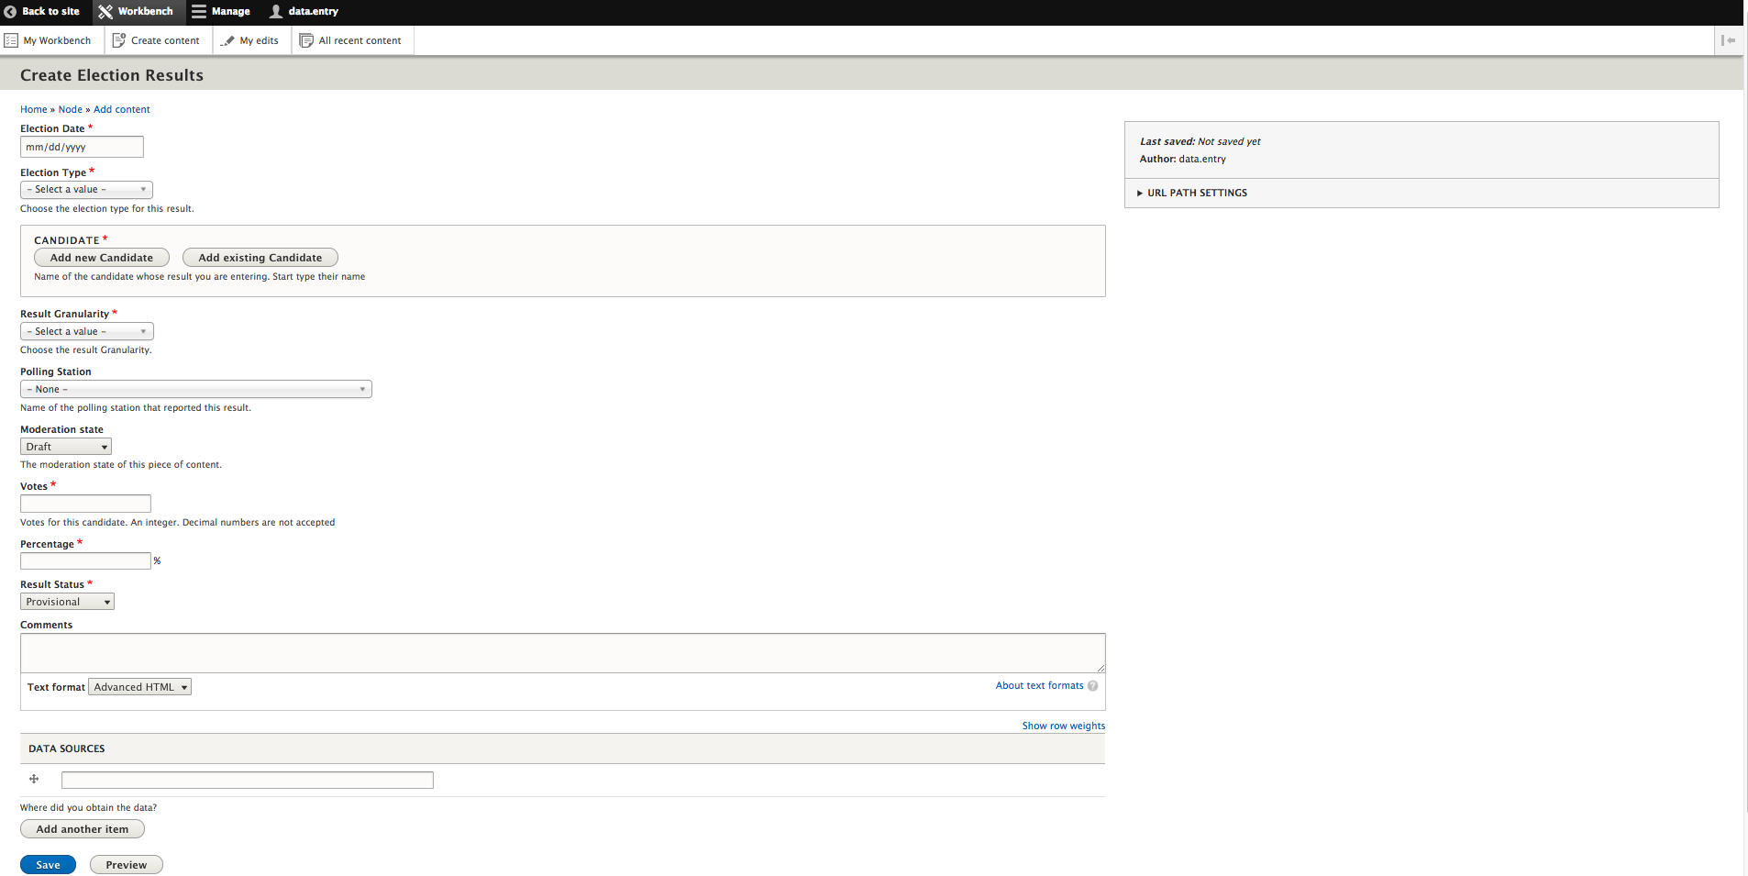
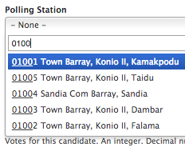
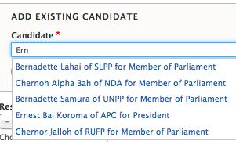
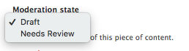
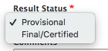
Sample Web-based Data Entry Forms
LAMTECH.SL

Slide 16
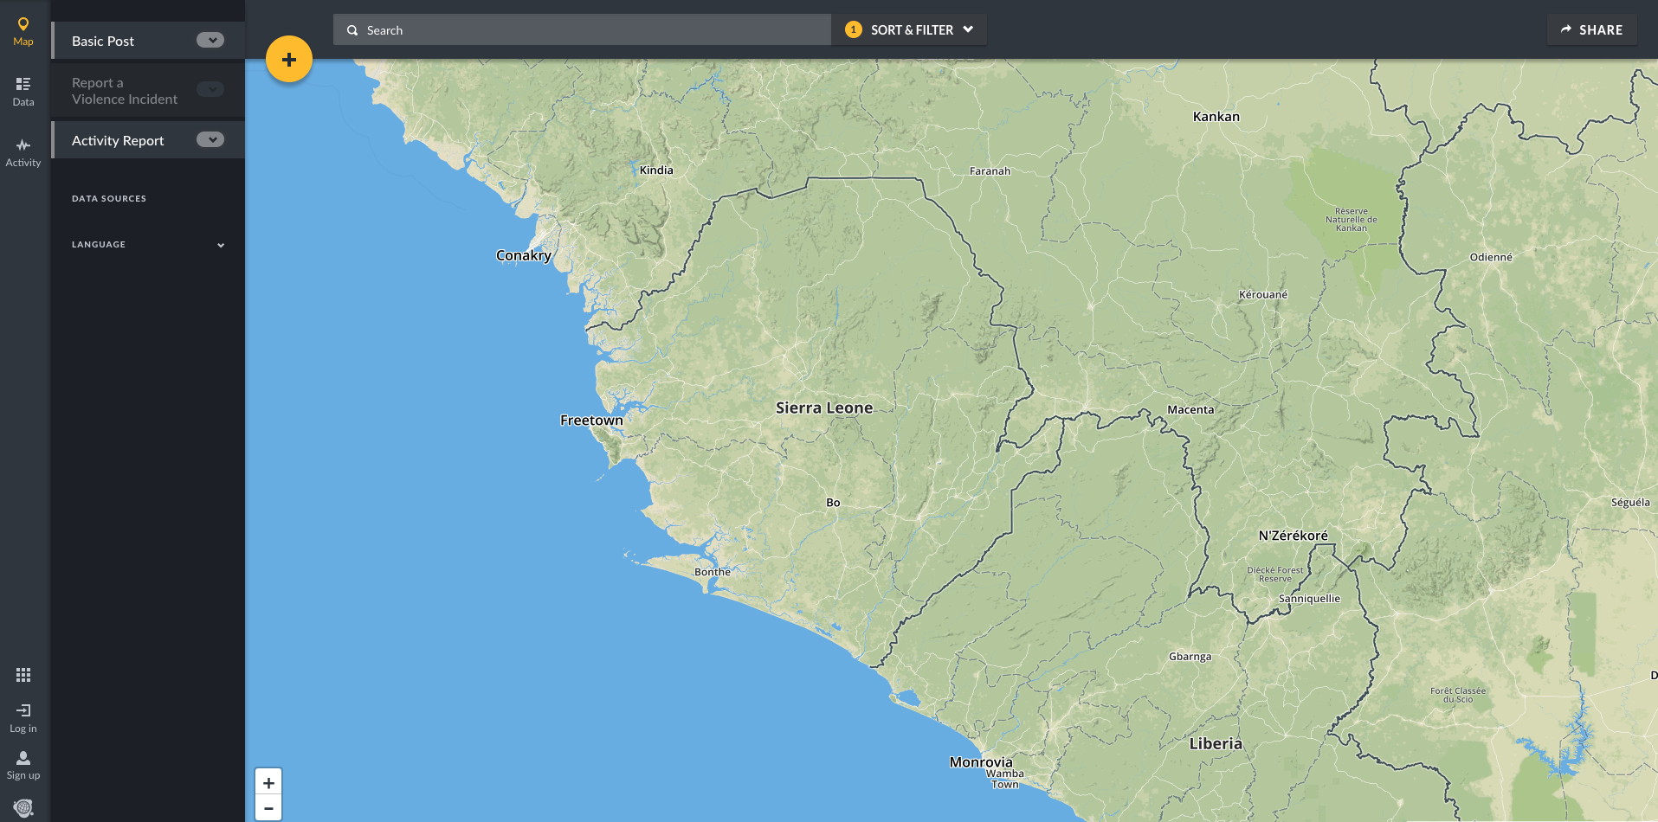
Electoral Violence Education & Reporting
LAMTECH.SL

Slide 17
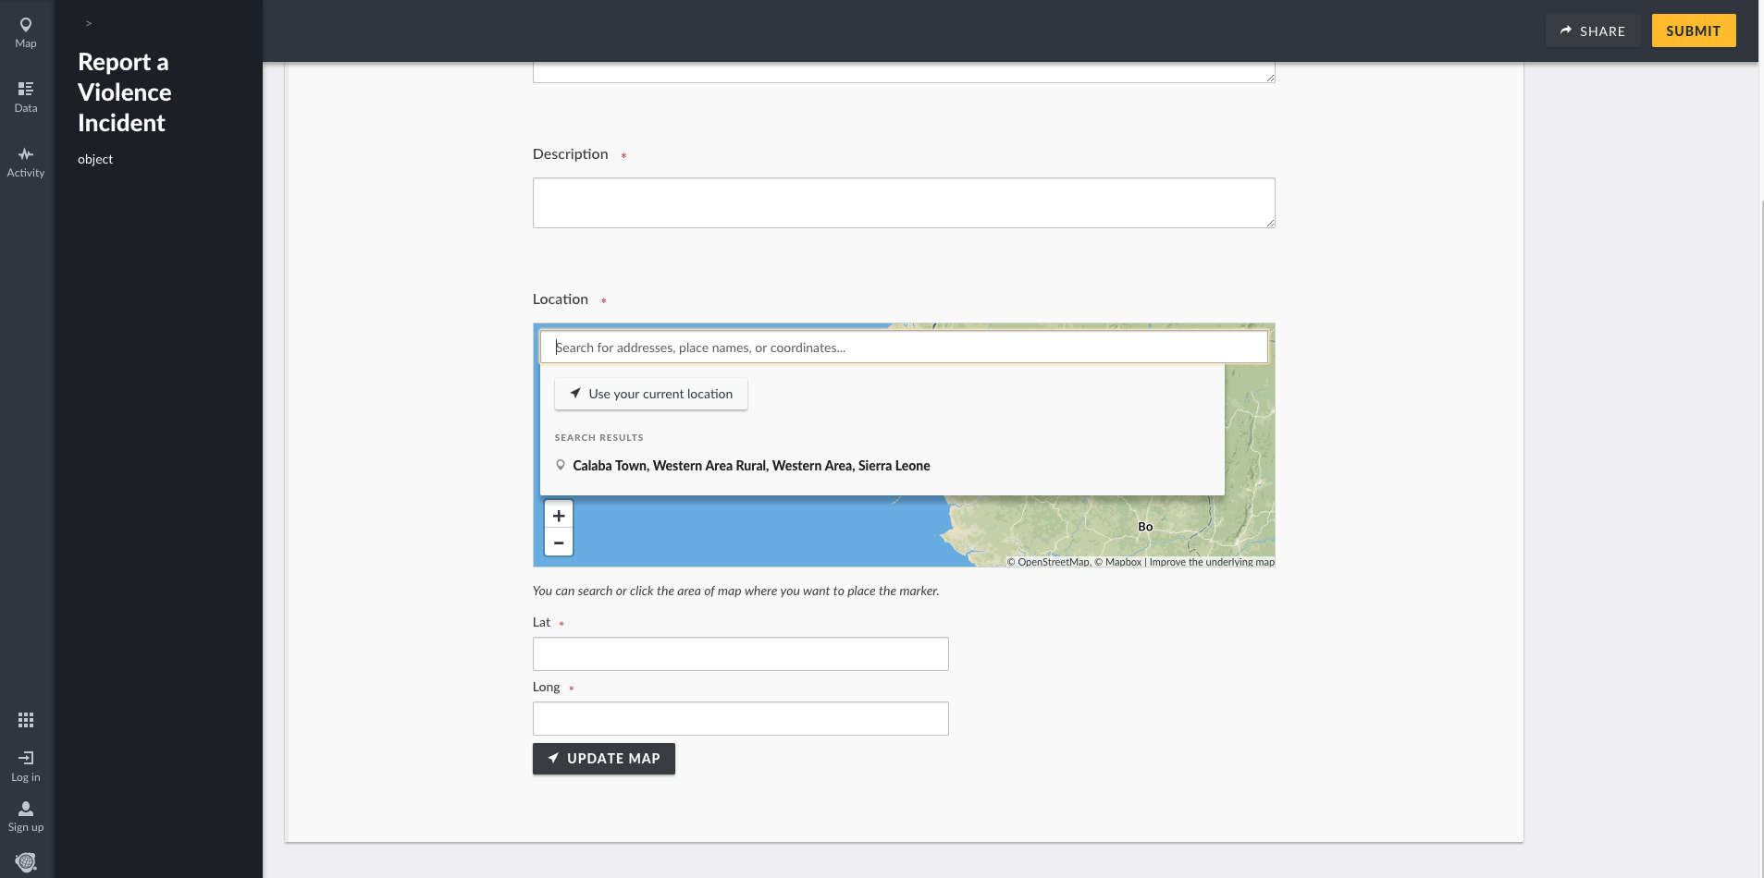
Sample Web-based Data Entry Forms
LAMTECH.SL

Slide 18
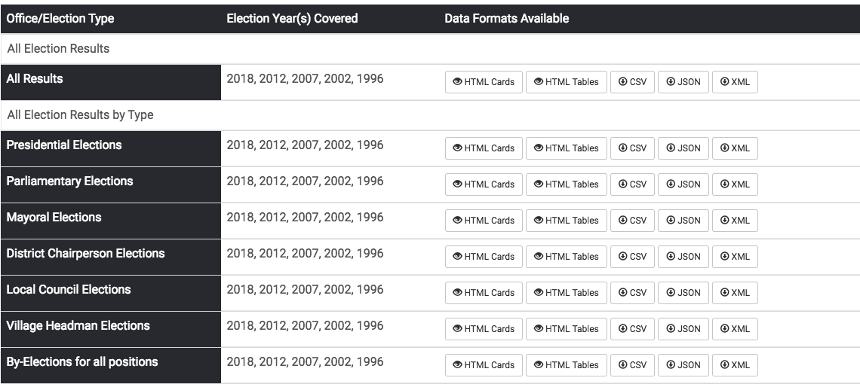
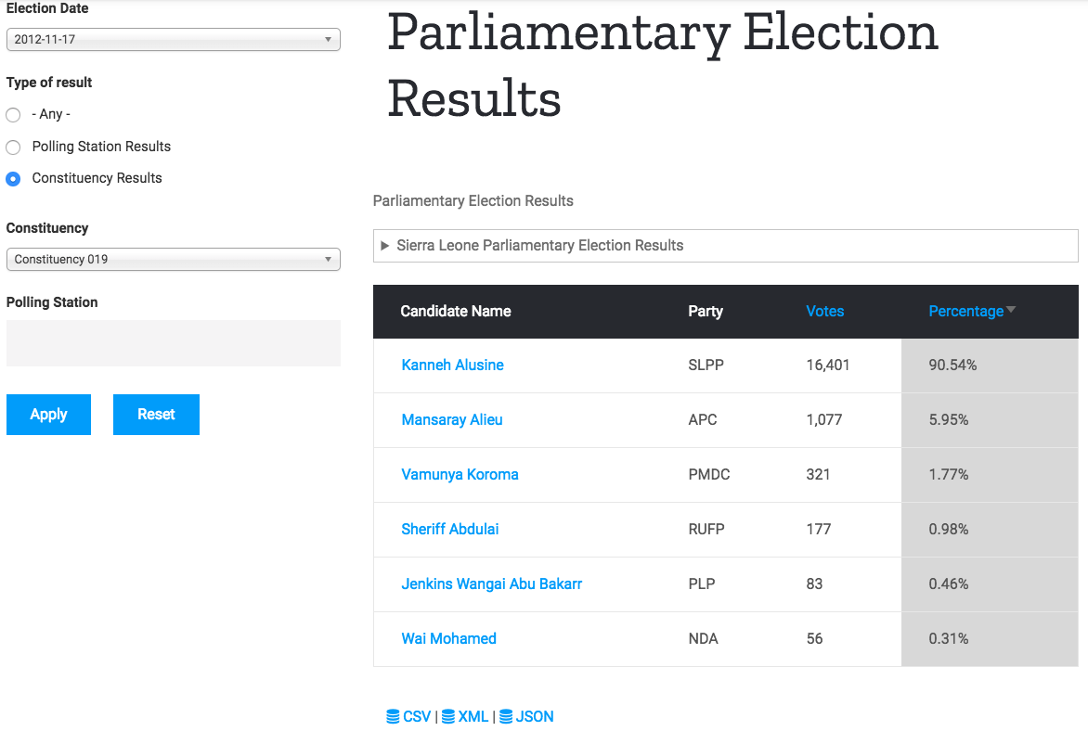
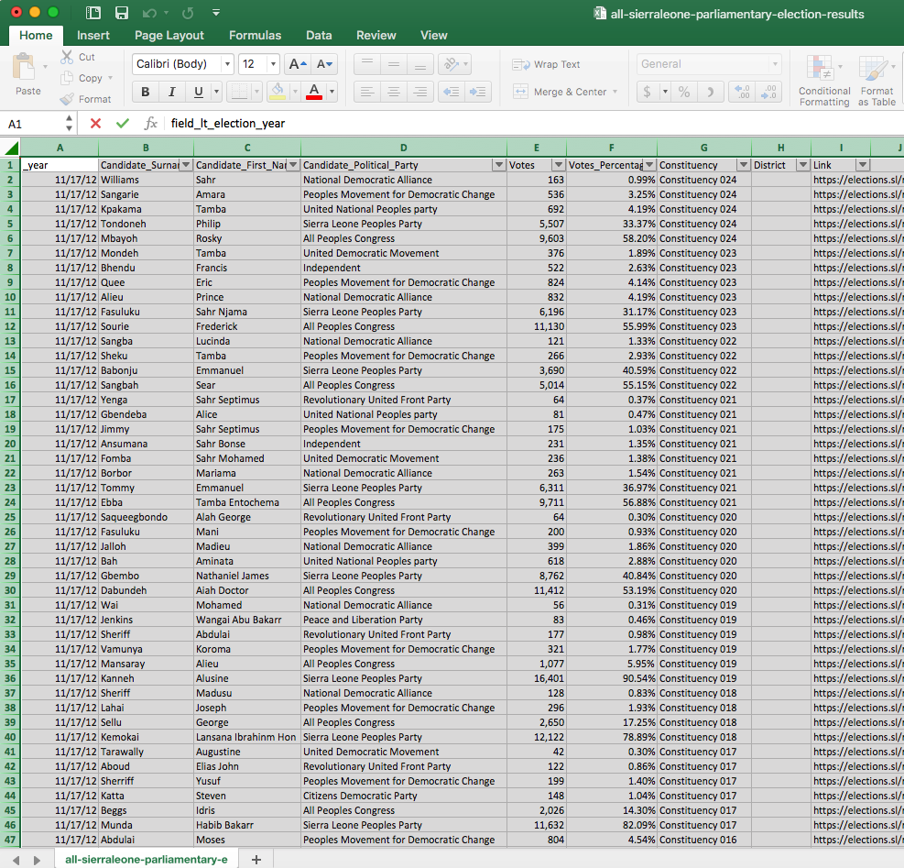
Sample Data Aggregating Screens
LAMTECH.SL

Slide 19
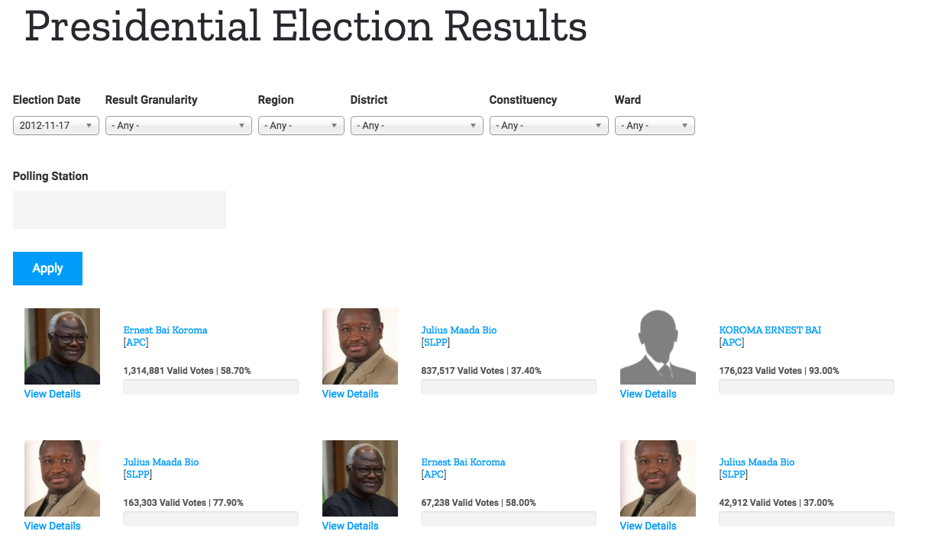
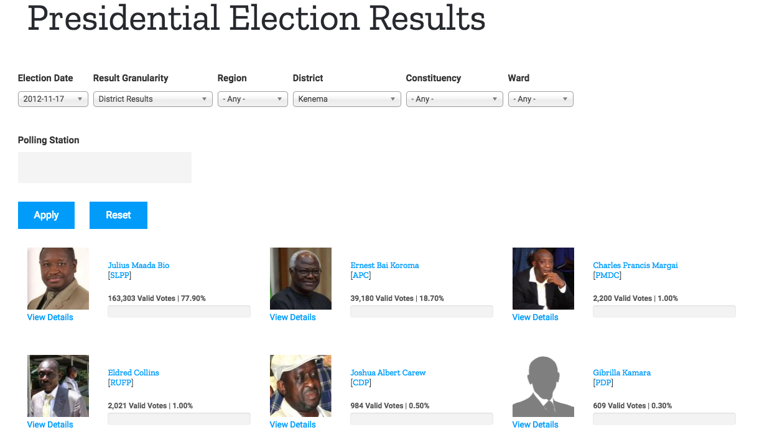
Sample Data Visualization Screens - Cards
LAMTECH.SL

Slide 20
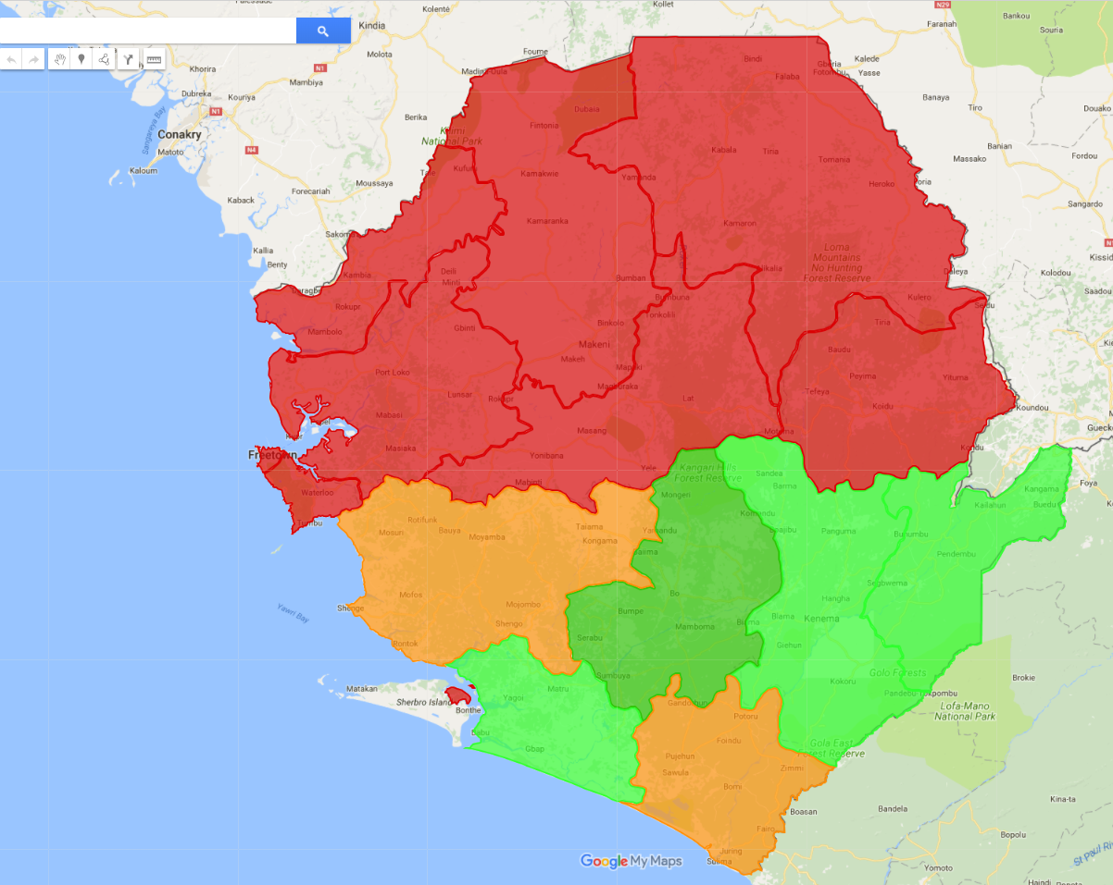
Sample Data Visualization Screens - Maps
LAMTECH.SL

Slide 21
Sample Data Sharing Screen
LAMTECH.SL

Slide 22
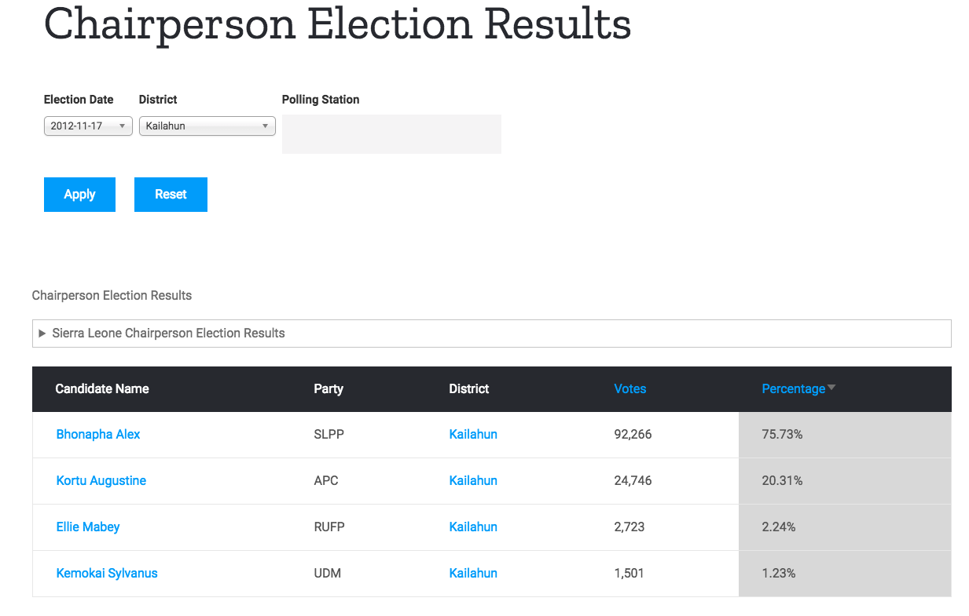
Human-Readable Formats: HTML Tables
LAMTECH.SL

Slide 23
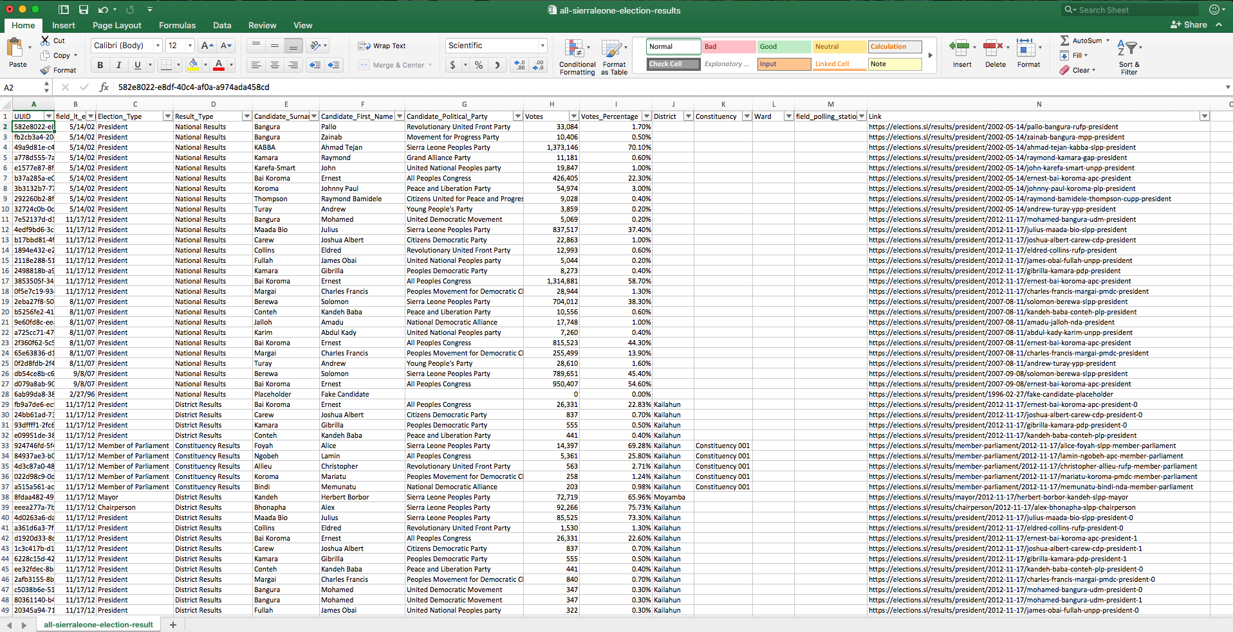
Machine-Readable Formats: CSV
LAMTECH.SL

Slide 24
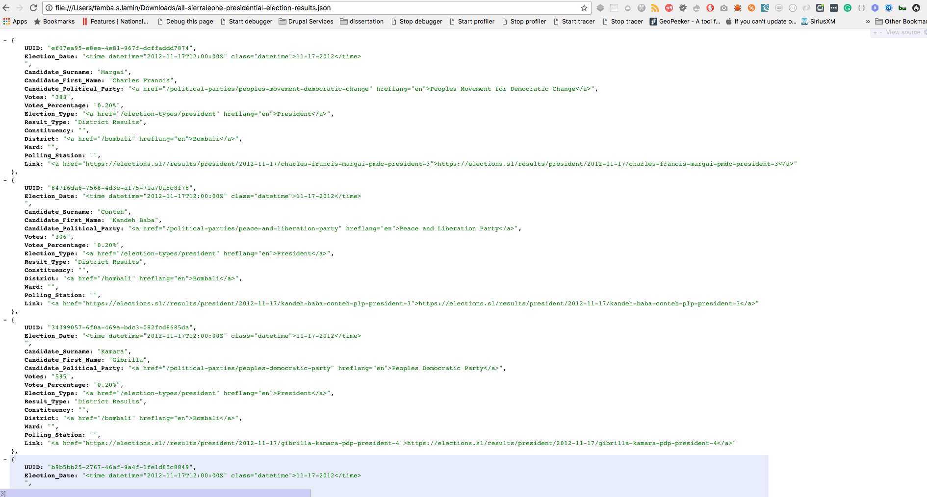
Machine-Readable Formats: JSON
LAMTECH.SL

Slide 25
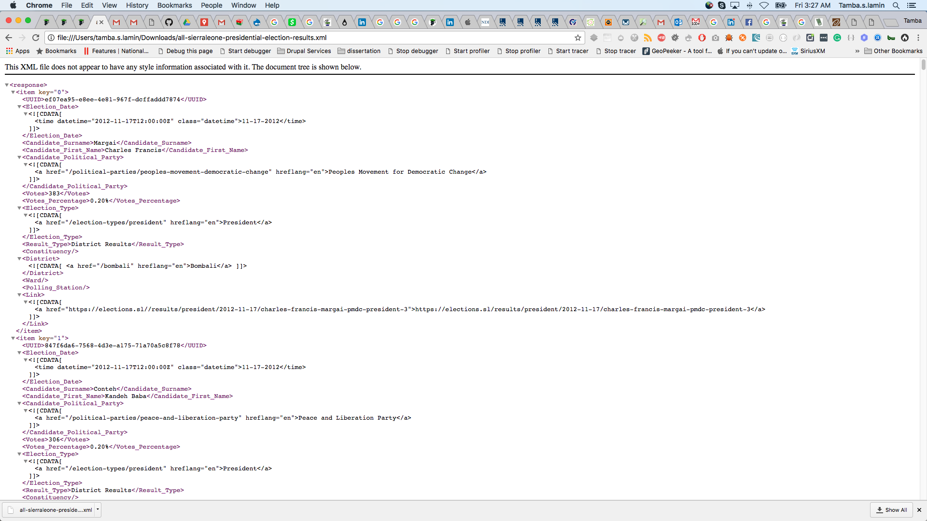
Machine-Readable Formats: XML
LAMTECH.SL

Slide 26
Security
LAM-TECH have years of experience working with governments and fortune 500 Inc. around the globe.
In 2011, The CEO of LAM-TECH contributed the following article about the security of government websites in Sierra Leone http://sierraexpressmedia.com/?p=27982
LAMTECH.SL

Slide 27
Infrastructure Security
We are using a "N-tier Architecture (Separated data, business logic, and presentation layers) - We have a dedicated server that host the database, a dedicated server for the backend application and a dedicated server for the frontend application.
In addition to the above, we are using one of the top content delivery network (CDN) providers in the world with servers in Africa that are closer to Sierra Leone than those in Europe or America.
The CDN provider is the only outsider that have direct access to our servers. All traffic from end users is handled by this provider. This provider filters bad traffic and only allows good traffic. They also prevent the platform from DDoS attacks and much more.
Our developers working on the servers have direct access to the servers via SSH only. Password-authenticated is not safe and hence is not allowed.
LAMTECH.SL

Slide 28

Security Architecture
Public using https://electiondata.io
Internet
Partner Control Plane
Internet Gateway
https – SSO connection
CDN Control Plane
https
Firewall
https
Content Delivery Network/Web App Firewall
Data Editors, Testers and Publishers
The LAM-TECH Cloud Control Plane
https
https
Internet
Gateway
15F
Dedicated VPC
Balancer
Balancer
LAM-TECH Control Plane
Internet Gateway
Web Tier
Web Tier
Firewall
Memcache
Memcache
SSH connection
File System/
Database Tier
File System/
Database Tier
Availability Zone 1
Availability Zone 2
Developers
Security Group
Virtual Private Gateway – EU Region

Slide 29
Platform and Frontend Security
Backend application is based on a widely used and secured Web Content Management System that is used by more than 48% of US Federal Government Websites and much more.
The platform is available via https only.
We enforce complex password requirements based on United States Federal Risk and Authorization Management Program (FedRAMP) and Defense Information Systems Agency (DISA) security standards.
Every piece of content managed by the platform is version controlled.
The system keeps track of every change including the IP address and other details.
We have a publishing workflow to ensure all content published was meant to be published by trusted individuals.
When we copy content from other sources, we give credit to those sources by referencing them and we do not change their original content
The individuals who will be responsible to publish content are considered trusted individuals within their communities.
LAMTECH.SL

Slide 30
Development Environments and Workflow
Code(Modules, Themes[Templates, CSS, JS], Configuration)
Development
QA Testing
Production
Code
Code
Code
Files
Files
Files
Database
Database
Database
Content from Database and User Uploaded Files (Images, docs and etc.)
LAMTECH.SL

Slide 31
Development Environments and Workflow
Code
Core and core patches
Contrib Modules
Custom Modules
Themes – php, html, css, js
Configuration – yaml, php
Code
Developer 1
Environment
Files
Database
Cloud Development Environment
Code
Files
User uploaded
Images
Videos
Docs
Developer 2
Environment
Files
Database
Code
Developer Nth
Environment
Files
Database
Content
Configuration in database
Select & Sanitized CMS user
Database
LAMTECH.SL

Slide 32
About LAM-TECH Consulting
LAM-TECH Consulting Enterprises
LAMTECH.SL
Notes:
An Open Source elections database platform following the nine open elections data principles developed by the Open Elections Data Initiative (OEDI)

Slide 33
Who We Are
We are a social business enterprise helping businesses, NGOs and governments improve existing intranet sites, digital platforms, web and mobile applications and public facing websites.
We are a group of Creative Thinkers, ICT Strategists, Technical Architects, Software Developers, Web Designers, User Experience Professionals, Open Data Experts, Open Source Lovers, Gen Xers, and Millennials called LAM-TECH Consulting Enterprises
We are a family owned business enterprise legally registered in Freetown, Sierra Leone as LAM-TECH Consulting and in New York as SaloneTech, LLC.
15+ professionals worldwide and growing through internships and in-house training
Strategically located in Sierra Leone, Mexico, India, United States, and Canada
Our dates back to May 2001, when we open a small computer training centre in Calaba Town called Memaa Information Technology Services.
We have a small full-time team of five Developers and more than twenty part time ICT Consultants dispersed across the globe.
LAMTECH.SL

Slide 34
What We Do
We help governments, NGOs, businesses and brands improve their existing intranets, platforms, social media, and websites.
We create innovative digital solutions, engaging tools, and customer experiences by providing a full range of ICT products, services and solutions
We help our customers define requirements, design ICT solutions, build windows-based software, web-based software, mobile applications, integrate ICT systems, test software/systems, deploy software and maintain ICT systems
We have PHP, ASP.NET, VBScripts, MYSQL, MS-SQL, HTML/HTML5, CSS/CSS3, and JavaScript developers.
We have expertise in developing, customizing and delivering Enterprise class web content management websites, intranet portals, customer relationship systems, human resource, asset, logistics and finance systems.
We are expert developers and contributors to Drupal, WordPress, DotnetNuke, Ushahidi Crowd mapping software, Alfresco, OpenCBS Microfinance software open source technologies.
In the commercial space, we have experience working with Adobe Experience Management, and Sitecore web content management software,
LAMTECH.SL

Slide 35
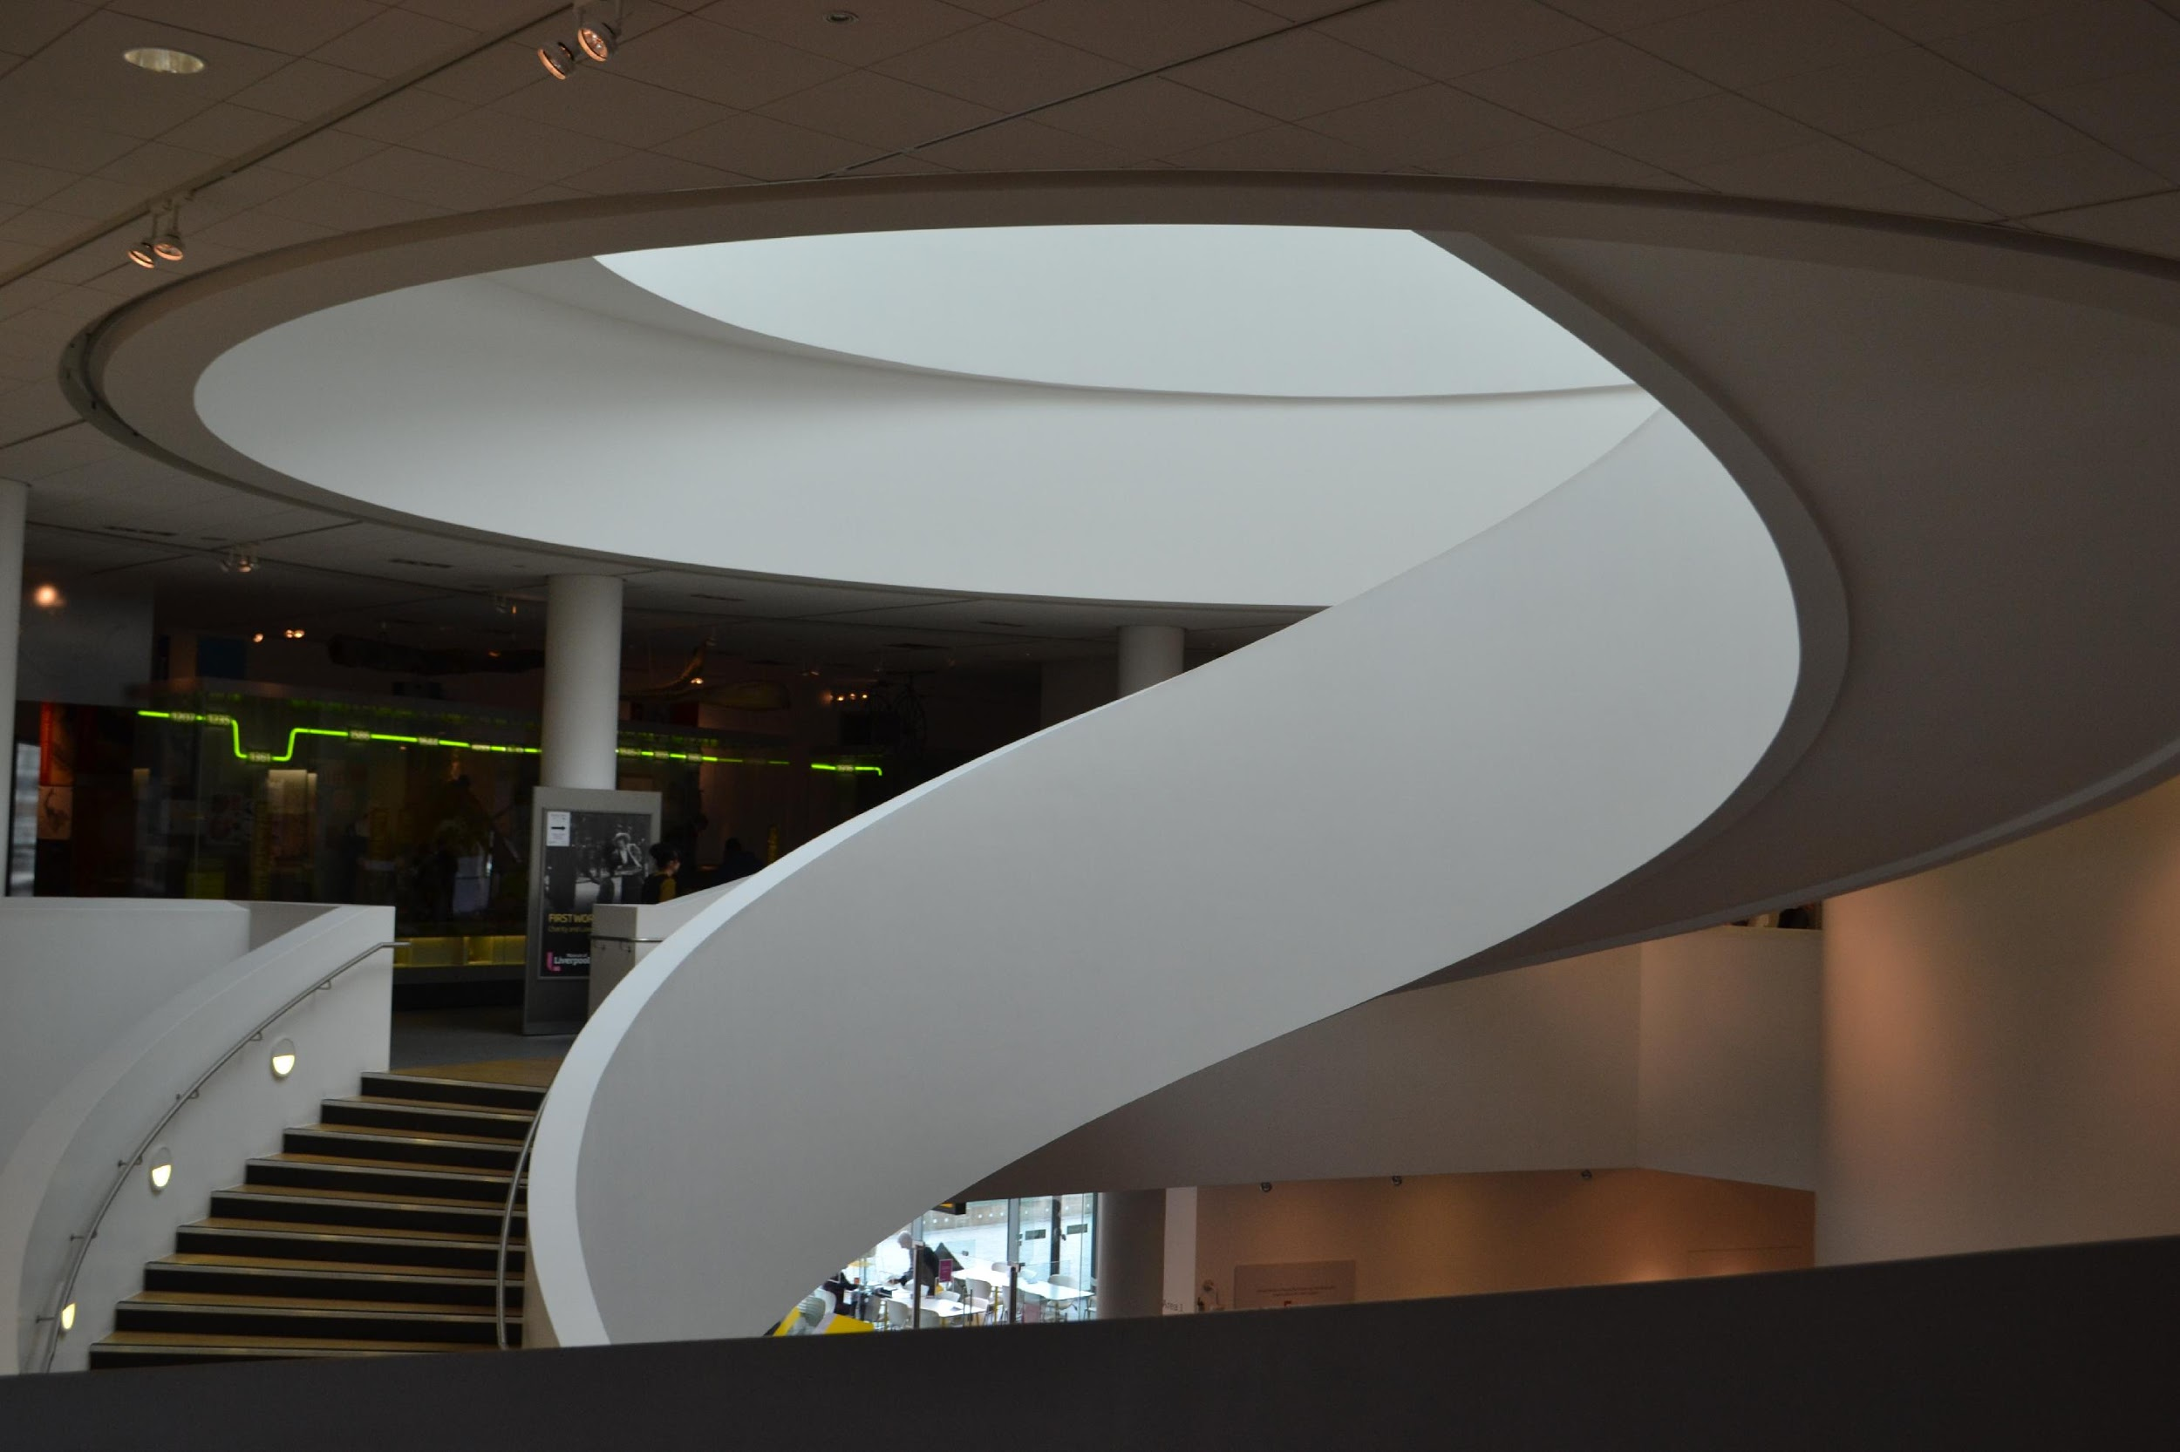


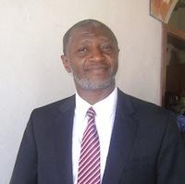


Core Team
Tamba S. Lamin
CTO/Chief Architect
Fallah I. Lamin
CTO/Senior Developer
Amadu Massally
COO/Product Manager
Patrick N. Sam
Administrator
Mohamed A. Jalloh
Senior Developer
LAMTECH.SL

Slide 36
Why do Business with LAM-TECH
Owned and Operated by industry Certified Information and Communication Technology experts with over 30 years’ combined experience
Most Affordable, Efficient and Reliable Tailor Made Software design Experts in Sierra Leone with local and overseas experience
24/7 email support for all clients
100% native Sierra Leonean owned
10% of profit goes to our charitable foundation – LAM-TECH Foundation Inc.
Uses new, modern and well known technologies, standard compliance codes to develop accessible, user friendly, interactive software applications carefully coded to meet customer requirements and maximize total organization value
LAMTECH.SL

